Slide 1
CST2550 - 2025
Software Engineering and Management
Week 7: Debugging and Testing Software
Ahmed Eissa
a.eissa@mdx.ac.uk

Slide 2
Learning Objectives
Master debugging techniques.
Implement comprehensive testing strategies.
Understand test-driven development.

Slide 3
1. Introduction
Notes:
https://learn.microsoft.com/en-us/azure/devops/boards/queries/import-work-items-from-csv?view=azure-devops

Slide 4
Debugging Techniques
Software Testing is the process to identify the origin of errors.
Advanced Debugging
  Memory Debugging
    Detect memory leaks and improper memory usage.
    Tools: Memory Usage tool in Visual Studio.
Performance Profiling
  Analyse application performance.
  Tools: Performance Profiler in Visual Studio.
Remote Debugging
  Debug applications running on a different machine.
  Set up Visual Studio Remote Debugger.

Slide 5
Testing Strategies
Unit Testing
  Test-Driven Development (TDD)
    Write tests before writing the implementation.
    Red-Green-Refactor cycle:
      Write a failing test (Red).
      Implement the code to pass the test (Green).
      Refactor the code.
  Mock Objects and Stubs
    Simulate dependencies to isolate units of code.
    Mocking frameworks: Moq, NSubstitute.
  Code Coverage
    Measure the percentage of code executed by tests.
    Aim for high coverage but focus on meaningful tests.

Slide 6
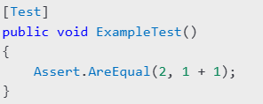
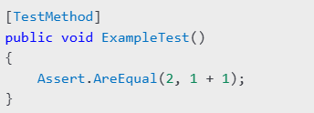
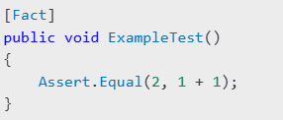
Testing Strategies
Testing Tools
  NUnit: Popular testing framework for .NET.
  MSTest: Microsoft's built-in testing framework.
  xUnit: A flexible, extensible testing framework.

Slide 7
Integration Testing
End-to-End Testing
  Validate the flow of an application from start to finish.
API Testing
  Test APIs for correctness, performance, and security.
  Tools: Postman, Swagger.
Automated Testing
  Use tools to execute tests automatically.
  Frameworks: Selenium, Playwright.

Slide 8
Why Test Software Before Release?
Prevention of Costly Errors
  Bugs found after release can be expensive to fix and may harm the organisation's reputation.
Improved Software Quality
  Ensures functionality, performance, and security are up to standard.
Customer Satisfaction
  A well-tested product provides a better user experience and reduces support requests.
Examples of Failed Releases Due to Lack of Testing
  Knight Capital Group (2012)
    A deployment error caused by untested code resulted in a $440 million loss within 45 minutes.
    Highlights the critical need for rigorous testing, especially in financial software.
  Windows 10 October Update (2018)
    Released without sufficient testing, leading to data loss for users.
    Demonstrates the importance of thorough end-to-end testing before public release.

Slide 9
Practical Examples
Debugging Workflow
  Set breakpoints in Visual Studio.
  Run the application in Debug mode.
  Use Watch Windows and Call Stack to diagnose issues.
Unit Testing Example
  Create a new test project in Visual Studio.
  Write a simple test case using NUnit, MSTest, or xUnit.
  Run tests and review results in the Test Explorer.

Slide 10
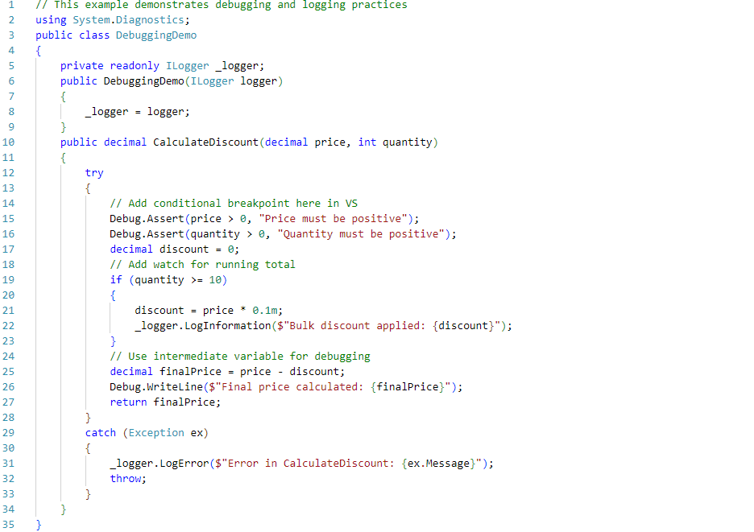
Example 1: Debugging and Logging

Slide 11
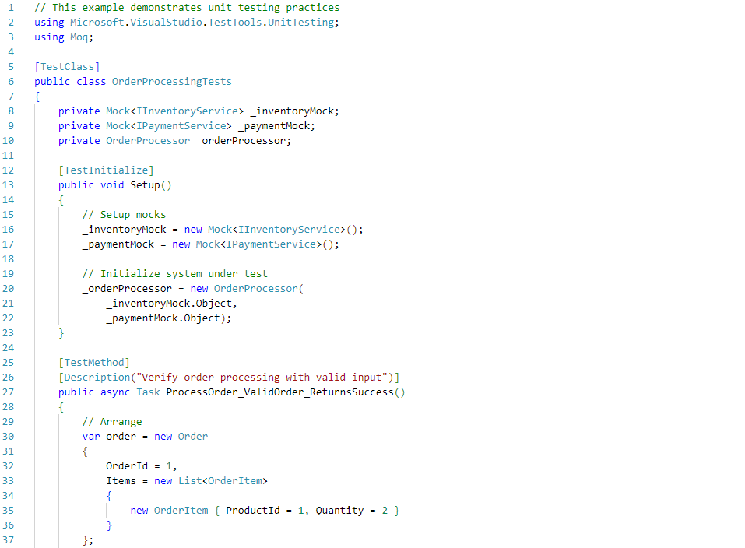
Example 2: Unit Testing with MSTest

Slide 12
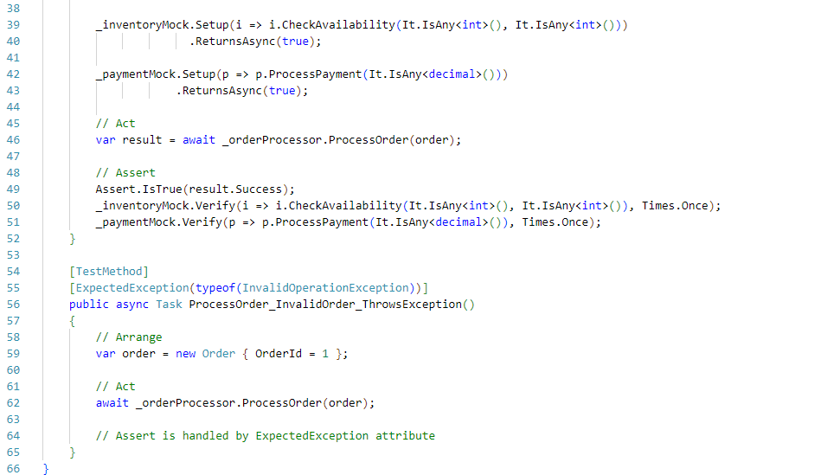
Example 2: Unit Testing with MSTest

Slide 13
Summary and Q&A
Debugging Techniques: Visual Studio Debugger, memory debugging, performance profiling, and remote debugging.
Testing Strategies: Unit testing, integration testing, TDD, and testing tools (NUnit, MSTest, xUnit).
Practical Demonstrations: Debugging and writing tests.

Slide 14
Discussion Questions:
How can debugging improve code quality?
What are the advantages of test-driven development?

Slide 15
Further Reading
Books:
  "The Art of Debugging" by Norm Matloff and Peter Jay Salzman.
  "Clean Code" by Robert C. Martin (Chapters on testing).
Online Resources:
  Microsoft Docs: Debugging in Visual Studio
  NUnit Documentation
  xUnit Documentation
Tools and References:
  Visual Studio Debugging Tools.
  Testing Frameworks: NUnit, MSTest, xUnit.
  Automated Testing Tools: Selenium, Playwright.

Slide 16
Next Week
Week 8: Analysis of Algorithms

